Slide 1
Alcohol Sale Trends in Iowa

Slide 2
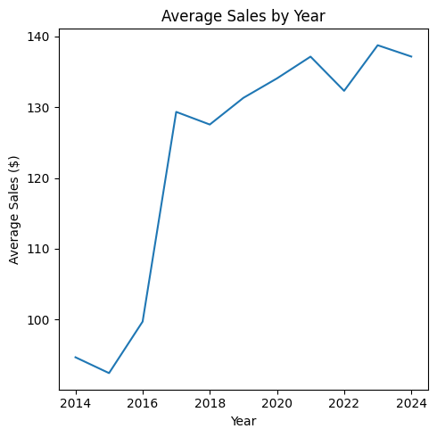
Analysis Methods
Merged in multiple data sets related to unemployment rates, county demographics and college towns
We grouped the dataset based off of county, creating features such as store count per county or average age within a county
Used linear regression to then calculate the least squares line to see if there is a strong association between the variable and sales.

Slide 3
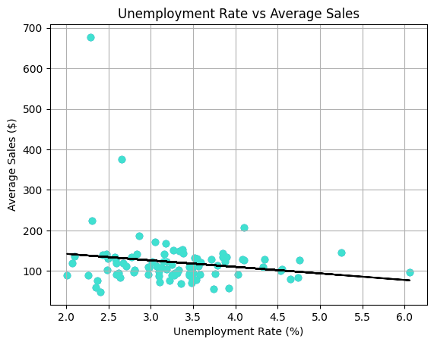
Unemployment Rate
y=-16.104x+174.686
Dallas
For each increase in the unemployment rate within a county, the average amount spent on an alcohol sale in that county goes down by $16.10
Grouped by County
Each point represents a county, with one clear outlier being Dallas County
MSE: 4861.68
Removing Dallas county brings the MSE down to 1652.04, which is what we want

Slide 4
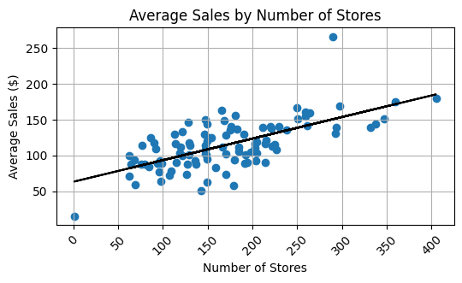
Liquor Store Density
Dallas
y = 0.301x + 63.360
For each increase in the number of stores within a county, the average amount spent in an alcohol sale goes up by 30 cents.
Grouped by County
Each point represents a county, with our two clear outliers being El Paso County and Dallas County
El Paso
R-squared: 0.430
The R-squared value of 0.43 means that about 43% of the variability in average sales is explained by the number of liquor stores. This suggests a moderate positive association

Slide 5
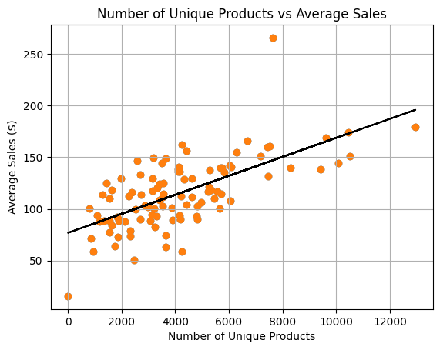
Liquor Product Variety
Dallas
y=0.009x+76.853
For each increase in the number of unique products within a county, the average amount spent on an alcohol sale in that county goes up by 0.9 cents.
Grouped by County
Each point represents a county, with our two clear outliers being El Paso County and Dallas County
R-squared: 0.431
The R-squared value of 0.43 means that about 43% of the variability in average sales is explained by the number of liquor products. This suggests a moderate positive association
El Paso

Slide 6
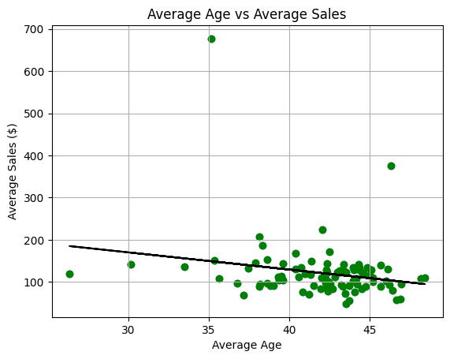
Age
Dallas
y = -4.07x + 292.562
For each increase in the average age within a county, the average amount spent in an alcohol sale goes down by $4.07.
Grouped by County
Each point represents a county, with one clear outlier being Dallas County
MSE: 4773.784
Removing Dallas County brings the MSE down to 1648.132, which is what we want

Slide 7
Conclusions
The higher the liquor store density, the higher the average sales
  More stores makes it easier to buy more alcohol
Liquor stores that have more unique products tend to have higher average sales
  More products means more things to try
The older people are, the less they spend on alcohol
  People drink less as they get older
The higher the unemployment rate, the less people spend on alcohol
  Employed people have more money to purchase alcohol

